Slide 1
GSRS Development Update
16 Nov 2018
TYLER PERYEA
DANNY KATZEL
NIH/NCATS

Slide 2
GSRS Status
High Level GSRS Core Status
GSRS 2.3.1 in production at FDA (October 2018)
2.3.1 public released
GSRS 2.3.2 development (November 2018)
Pre-production at FDA
Pending public release soon (December 2018)
GSRS 2.4 development (1st quarter 2019)
In development
Improved data exchange / communication

Slide 3
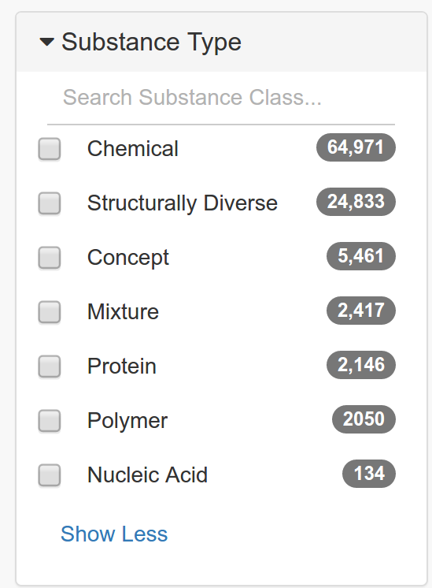
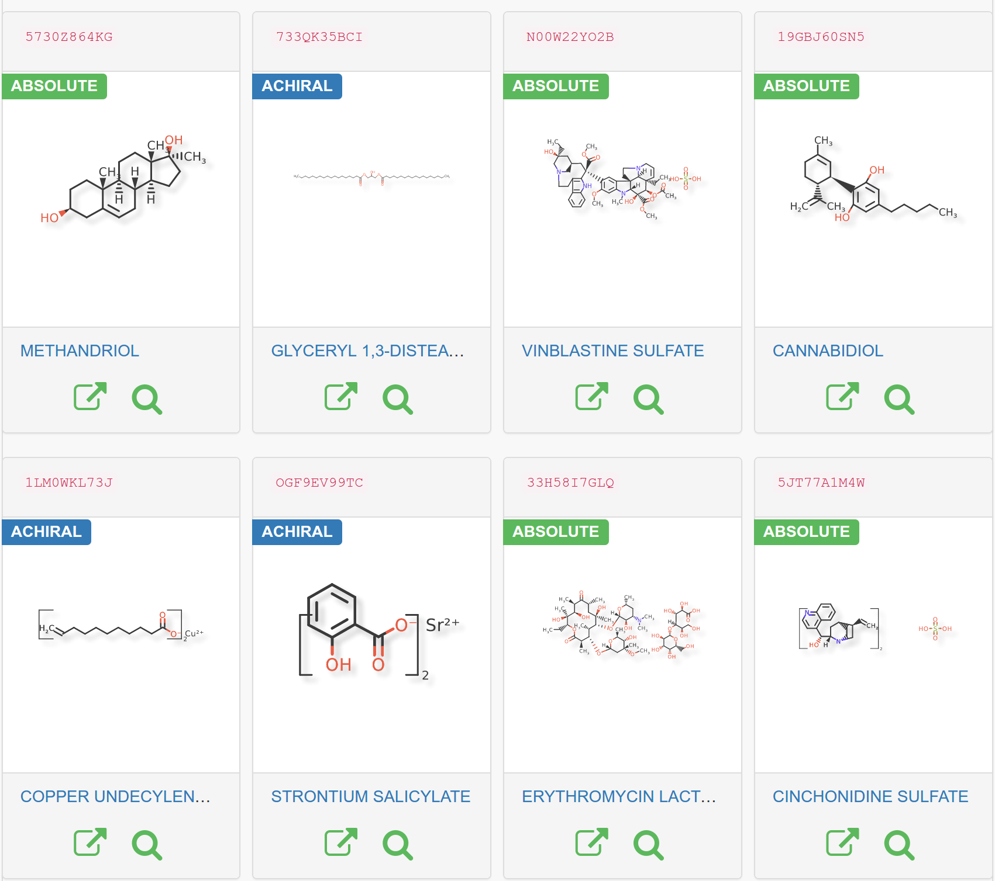
GSRS Status

Slide 4
GSRS 2.3.1 Status
GSRS 2.3.1 Improvements
Substance “Hierarchy” views
Additional Validation Rules
Improved Relationship Handling
Improved Structure Resolver
Configurable / modular Validation Engine
Porting of some FDA-specific enhancements to main code base
Bug fixes
Improved UI
New Guided Search

Slide 5
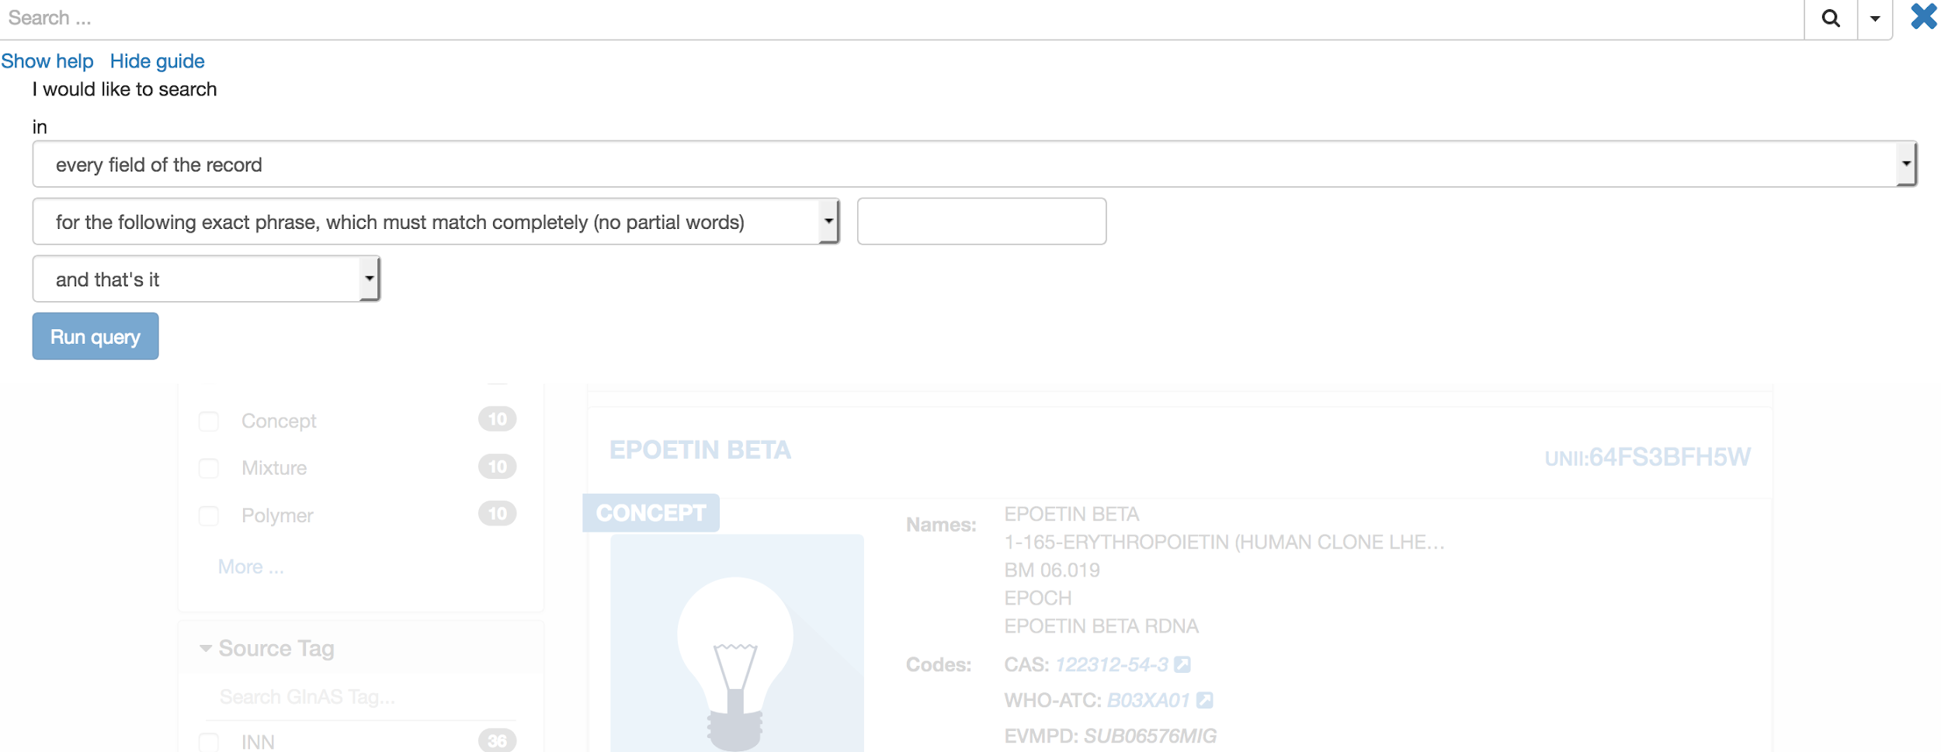

GSRS 2.3.1 New Search Guide

Slide 6
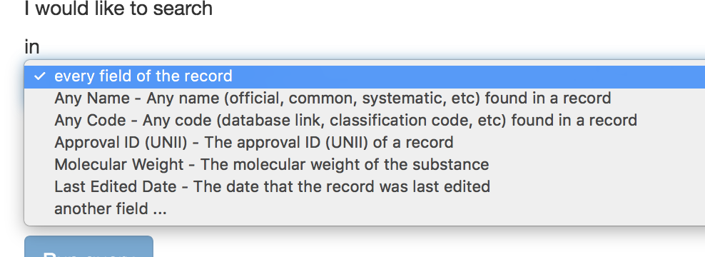
GSRS 2.3.1 New Search Guide

Slide 7
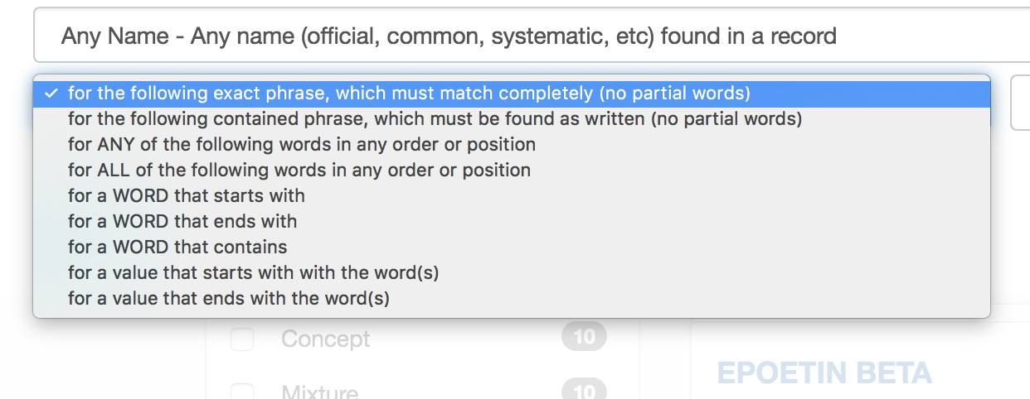
GSRS 2.3.1 New Search Guide

Slide 8
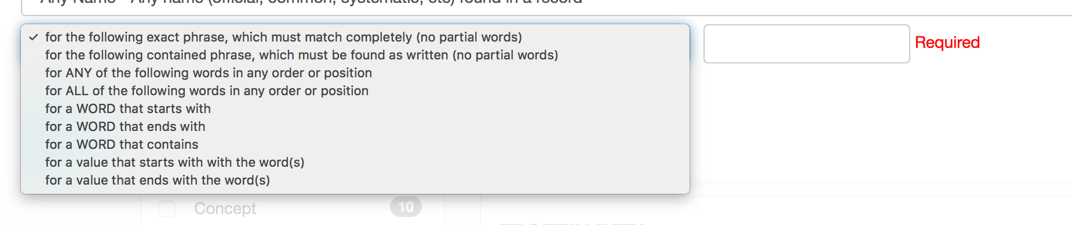
GSRS 2.3.1 New Search Guide

Slide 9
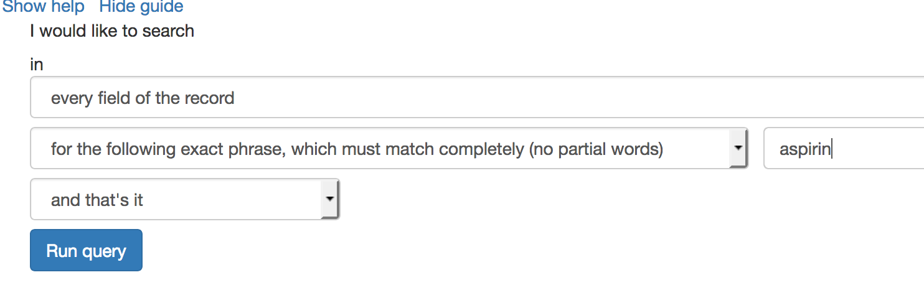
GSRS 2.3.1 New Search Guide

Slide 10
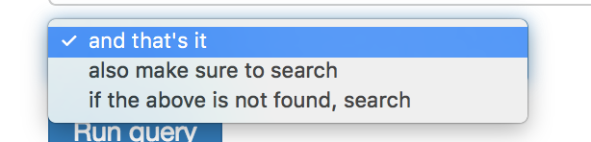
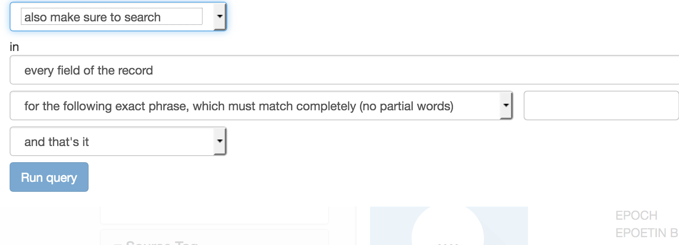
GSRS 2.3.1 New Search Guide

Slide 11
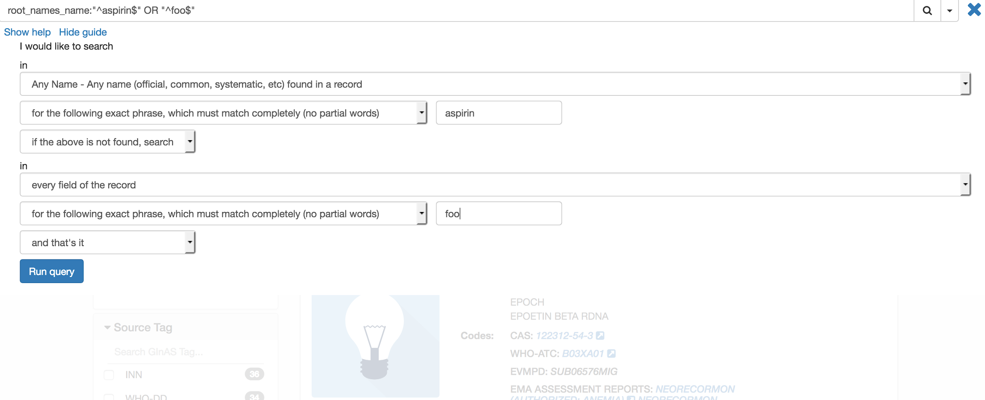
GSRS 2.3.1 New Search Guide

Slide 12
GSRS 2.3.2 Status
GSRS 2.3.2 Improvements
Improvements to rendering of molecules
Further improvements to guided search
Further improvements to duplicate check / sequence searching
Ability to easily revert records for authorized users
Additional stability and data integrity checks
Improvements to hierarchy view

Slide 13
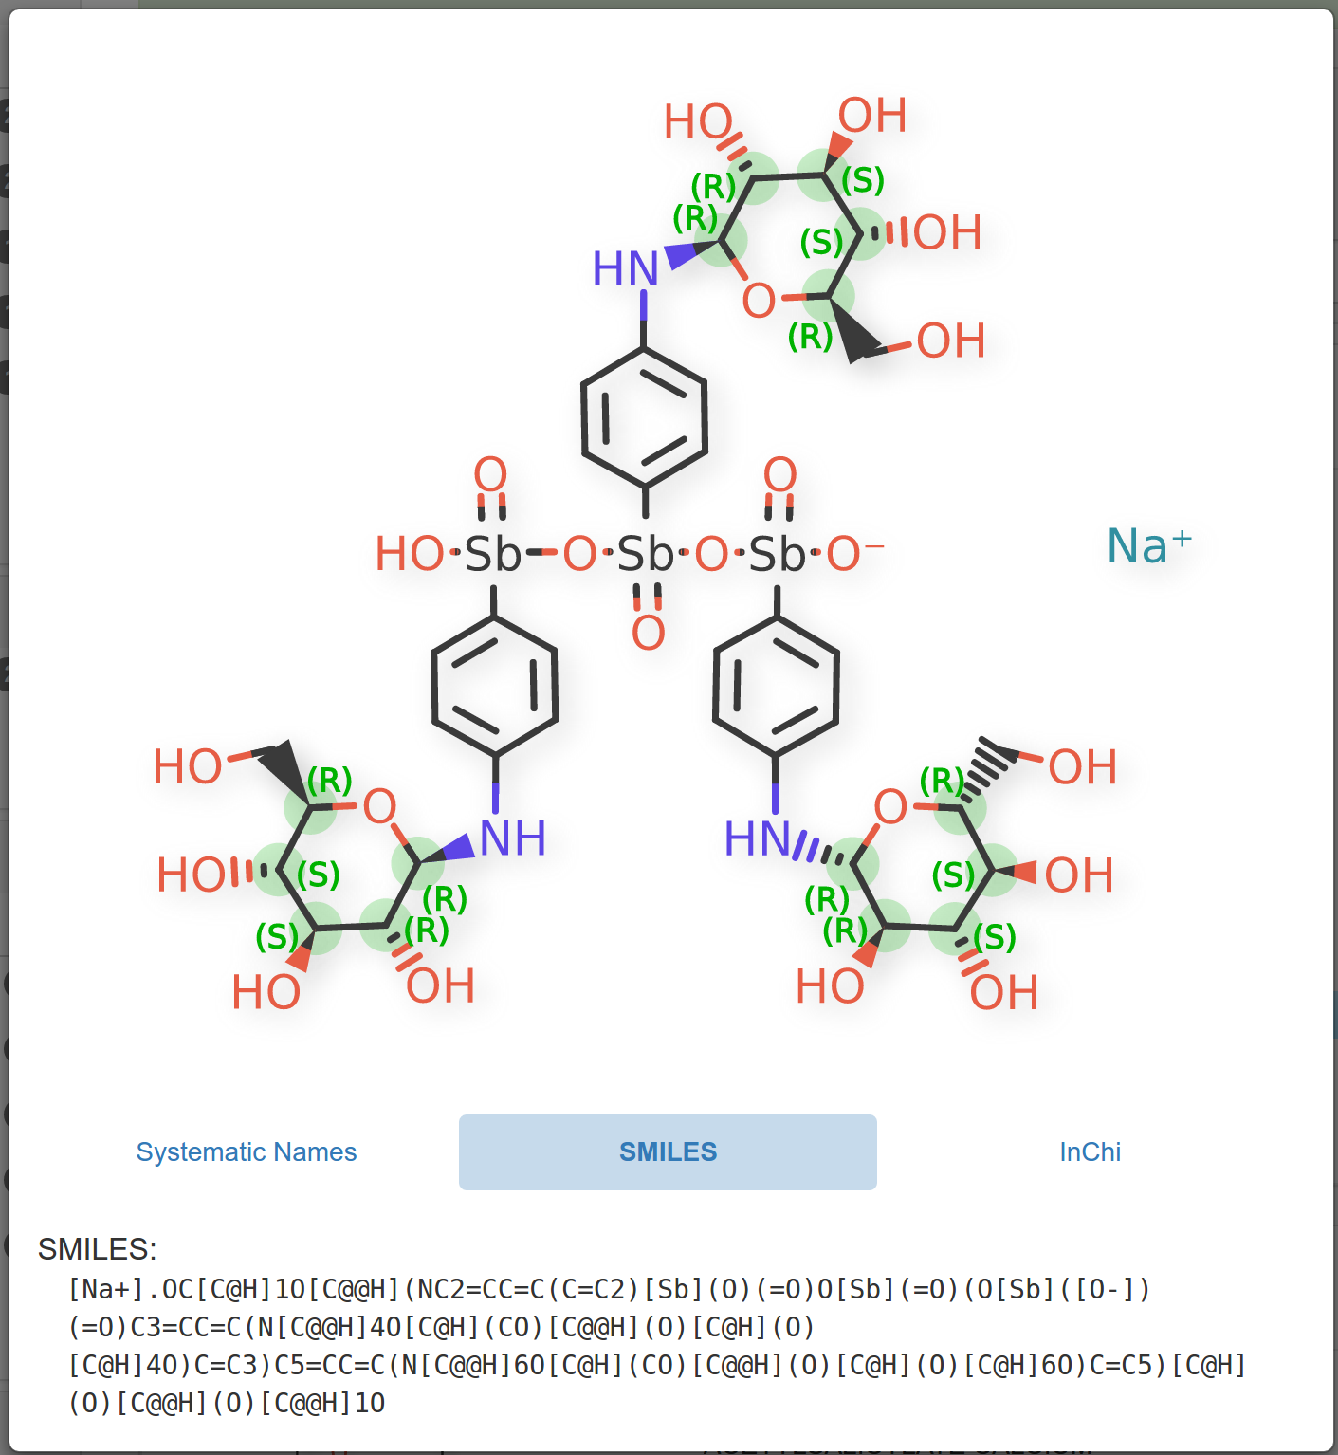
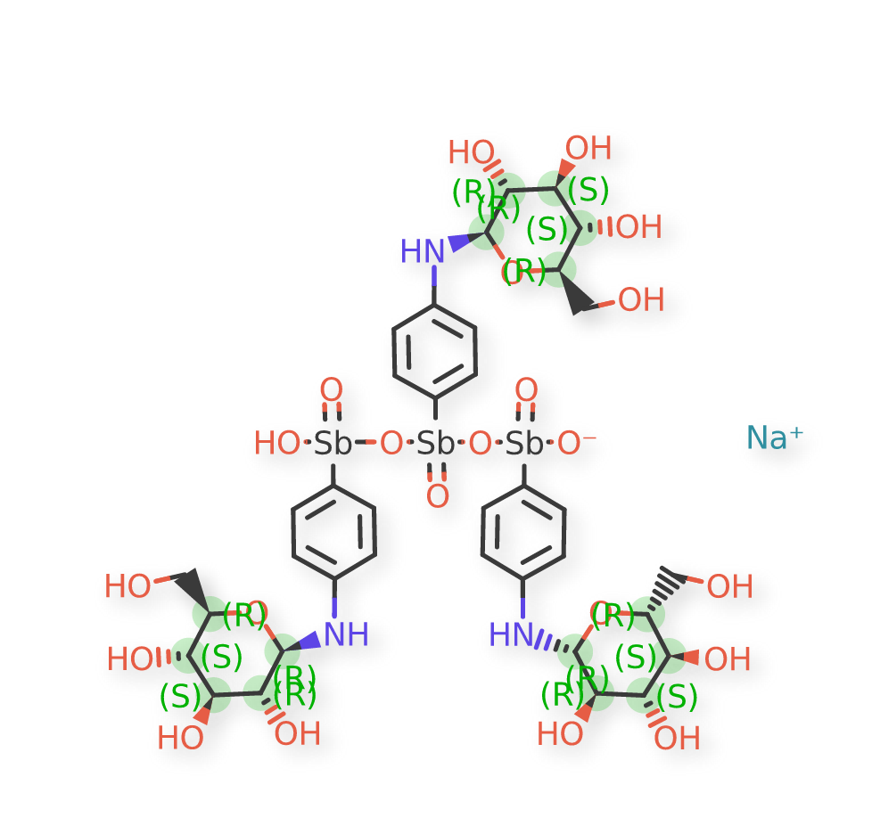
GSRS 2.3.2: Rendering
GSRS 2.3.1 (old)
GSRS 2.3.2 (new)

Slide 14
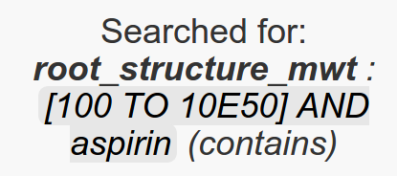
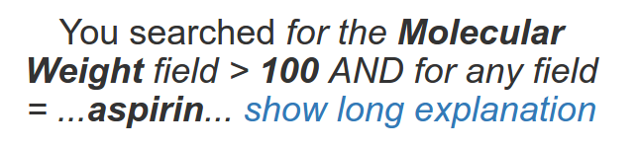
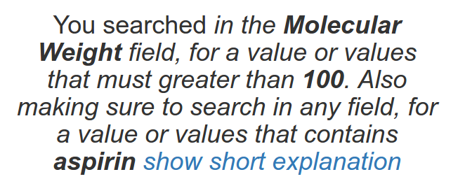
GSRS 2.3.2: Guided Searches
GSRS 2.3.1 (old)
GSRS 2.3.2 (new)
(a little opaque and inaccurate)
(more informative and accurate)

Slide 15
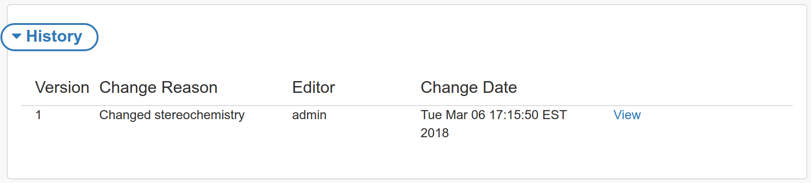
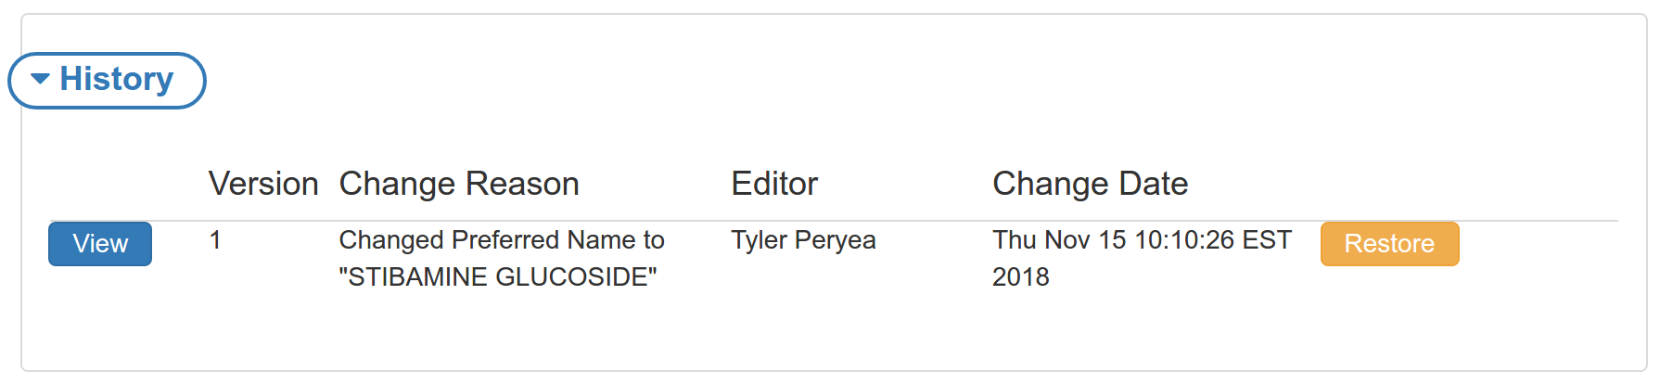
GSRS 2.3.2: Restoring Old Versions
GSRS 2.3.1 (old)
GSRS 2.3.2 (new)
Super users can view old versions, but involved process to revert
Super users can quickly revert records, after review

Slide 16
GSRS Status
On the horizon
GSRS 2.4
Submissions / System-to-system communication
Establishment of requirements document (complete)
Basic support for accepting / staging / processing new and modified records from external sources (1st quarter 2019)
Simplified installation / launch
High-level feasibility report (complete)
Basic support (1st quarter 2019)

Slide 17
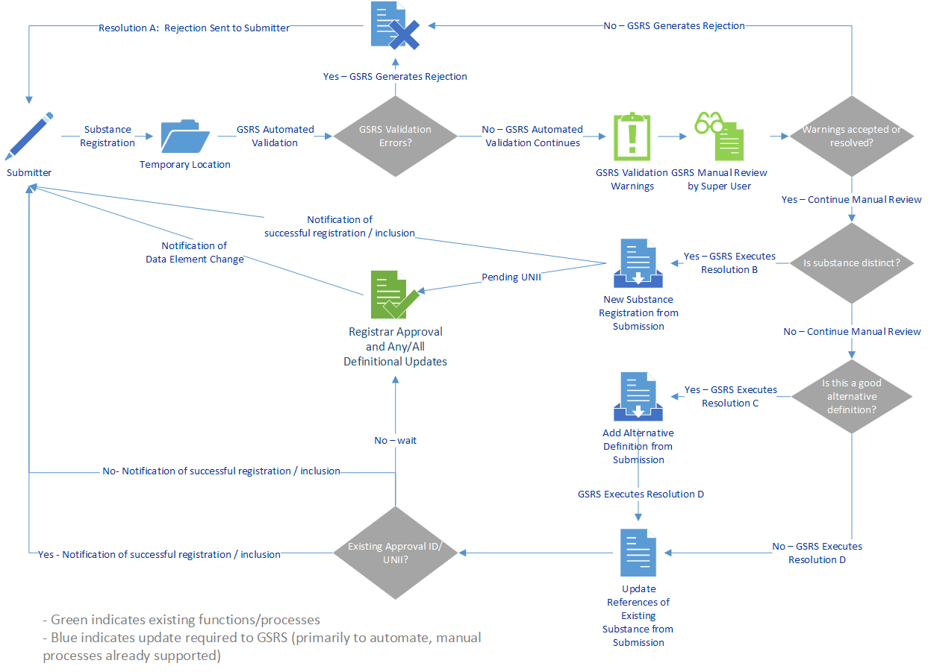
System Submission and Exchange Mechanism

Slide 18
GSRS Status
On the horizon
GSRS 2.5+
Improvements to REST API / Systematic access
Upgrade of UI to modern web framework for client-side UI
Angular 6+
Websocket support

Slide 19
GSRS Tools
GSRS Find excel tool (currently in alpha release)
Search, create, update, retrieve records and substance information in batches
Support for loading SD files
Stand-alone Java API library (1st quarter 2019)
Easier programmatic access to data for integration with other applications / stand-alone tools
Stand-alone Javascript API library (2nd quarter 2019)
Provides simple communication and data operations with running instance
https://tripod.nih.gov/ginas/

Slide 20
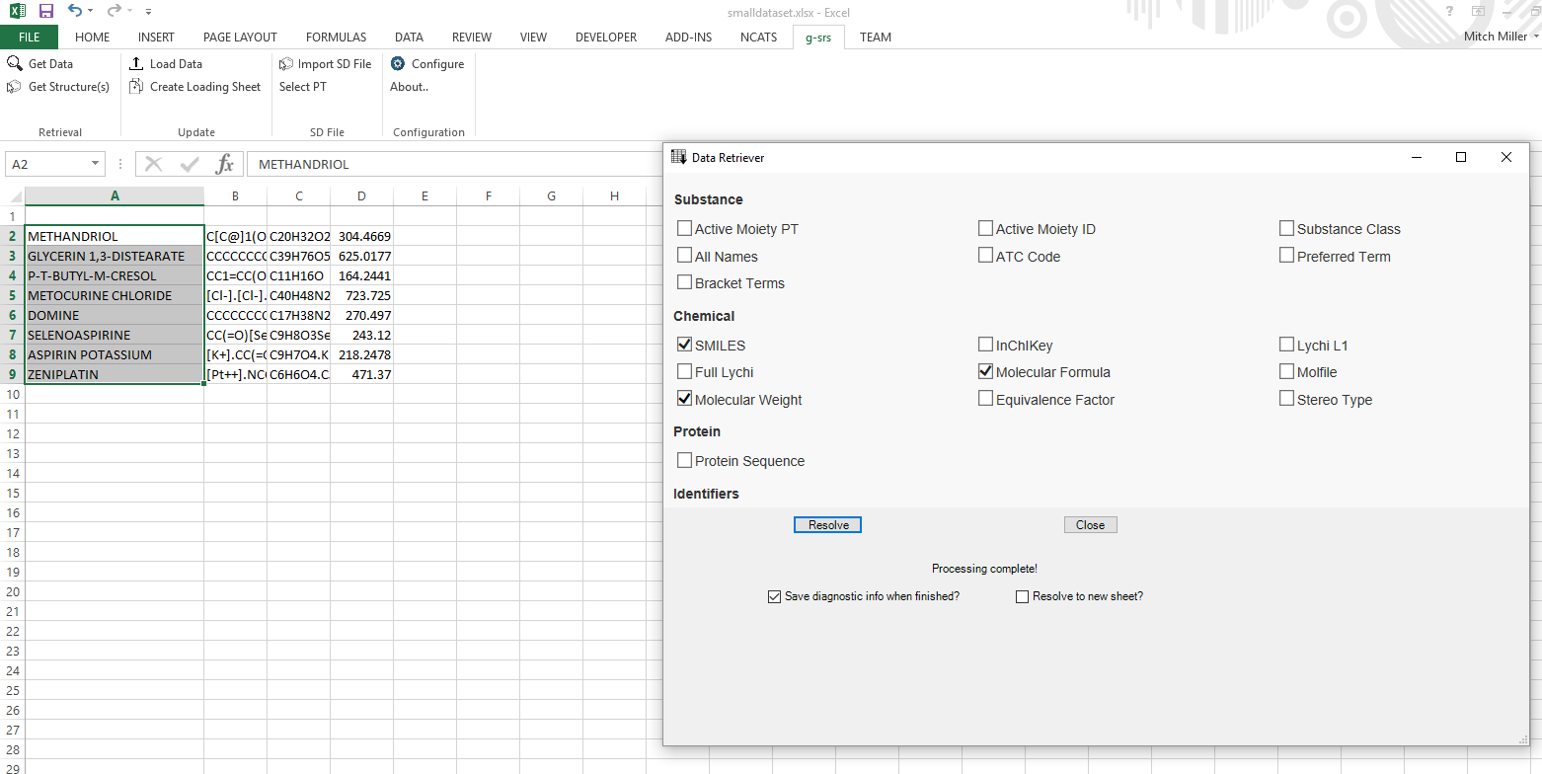
GSRS Tools: GSRS Find
1. Input names/codes
3. Results
2. Choose what you want
https://tripod.nih.gov/ginas/

Slide 21
GSRS Tools: Stand-alone Java API Library
try(GsrsRestClient client = DefaultGsrsRestClient.create("https://ginas.ncats.nih.gov/ginas/app")){
GsrsSearchResult result = client.searcher().substructure("C1=CC2=CC=CC=C2C=C1");
System.out.println("search results :");
System.out.println("total : " + result.getTotal());
System.out.println("top 10 substance names:");
result.getUuids()
.stream()
.limit(10)
.forEach(uuid->{
try {
Substance sub = client.fetchSubstance(uuid);
System.out.println(sub.getName());
}catch(IOException e) {}});
}
search results :
total : 1973
top 10 substance names:
NAPHTHALENE
POLYCYCLIC AROMATIC HYDROCARBONS
PHENANTHRENE
ANTHRACENE
BENZ(A)ANTHRACENE
TRIPHENYLENE
CHRYSENE
BENZO(C)PHENANTHRENE
TETRACENE
DIBENZ(A,H)ANTHRACENE
https://tripod.nih.gov/ginas/

Slide 22
Acknowledgements
NCATS
Tyler Peryea
Noel Southall
Dac-Trung Nguyen
Ivan Grishagin
Dammika Amugoda
Jorge Neyra
Niko Anderson
Mark Williams
Tim Sheils
Chris LeClair
Paul Shinn
Qian Zhu
Christine Colvis
Mark Williams
FDA
Larry Callahan
Frank Switzer
Yulia Borodina
Ramez Ghazzaoui
Elaine Johansen
Ta-Jen Chen
Archana Newatia
Mary-Ann Slack
Alex Welsch
Sarah Stemann
Yoshiyuki Tokiwa
Medicines Evaluation Board
Herman Diederik Ciska Matai
Marcel Hoefnagel Burt Kroes
Joris Kampmeijer
US Pharmacopeial Convention
Fouad Atouf
Andrej Wilk
Tina Morris

Slide 23
Questions

